Slide 1
Lecture No 03

Slide 2




Slide 3









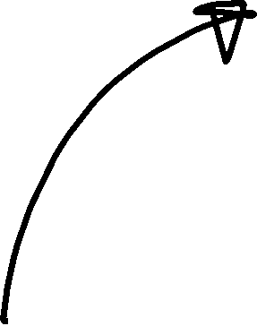





Slide 4























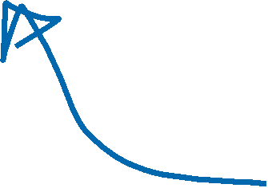















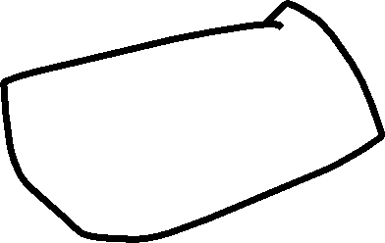
















































Slide 5




































Slide 6









































































Slide 7













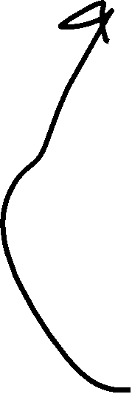











































Slide 16





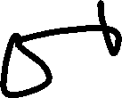


















































Slide 17







































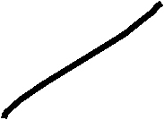

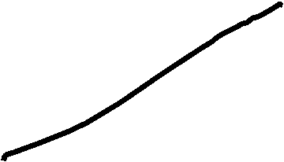

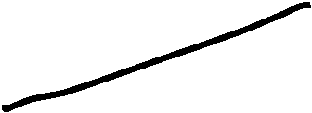





































Slide 18













































Slide 19












































































Slide 20











































Slide 21






























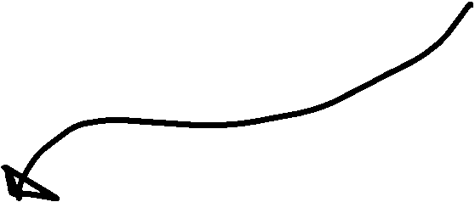
























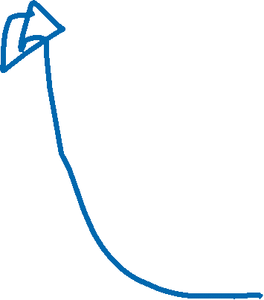








Slide 22









































Slide 23



















































Slide 24








































Slide 25




































Slide 26































































Slide 27








Slide 28
































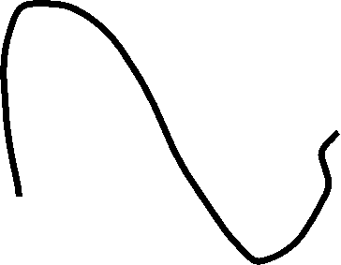





















Slide 29








































































Slide 30
